Slide 1
Infrastructure Automation with Terraform & Azure Devops on Azure cloud
Harshal Mittal

Slide 2
Setting up Frontend Section 4
Notes:
Lets setup up frontend section on the infrastructure in this lab.

Slide 3
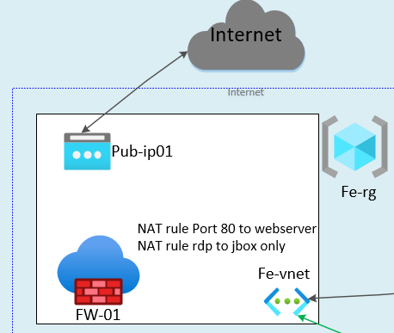
Setting up Frontend
Frontend portion of our lab.
Notes:
This is the frontend portion of the lab, which I am going to setup.

Slide 4
Frontend resources
Fe-rg (resource group)
Pup-ip01 (Public ip address)
Fe-vnet (Virtual Network) with 2 subnets
AzureFirewallSubnet Subnet
Jbox-subnet
FW-01 (Firewall)
Notes:
Planning ahead is really imported before deploying resources.
As per my plan I am going to deploy following resources in the lab
A resource group named Fe-rg.
A public ip address that will be used by the azure firewall.
A virtual network with 2 subnets
Azurefirewallsubnet will be completely dedicated for the firewall
And jbox subnet will be used by the jumpbox environment.
And once I have all the required components of the firewall like I have a subnet for firewall ready and public ip address is also deploy then in the last I am deploying the firewall.
So it is important to plan things ahead before deploying resources.
For example I am deploying 2 subnets as per my requirements.
Next thing deploying firewall after deploying the subnet and the public ip address for firewall.
Nat rules I am going to deploy in the last part of this section.

Slide 5
Demo
Notes:
Let s deploy the front end environment in the lab.

Slide 6
Setting up Backend
Next video
Notes:
Now we have setup our front end environment, In the next video I am going to setup the backend environment.

